Slide 1
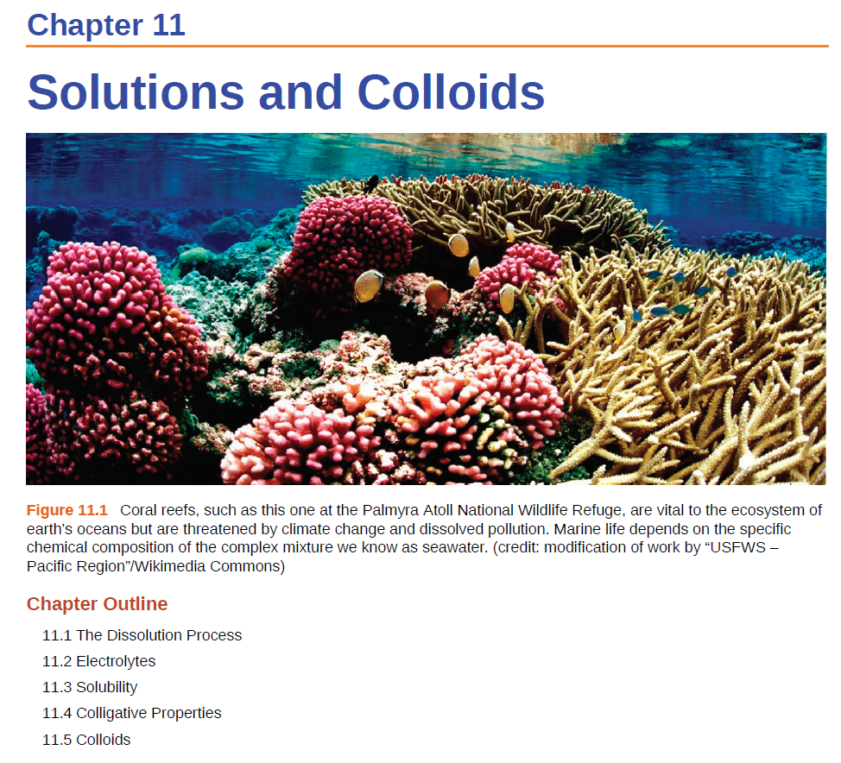

Slide 2
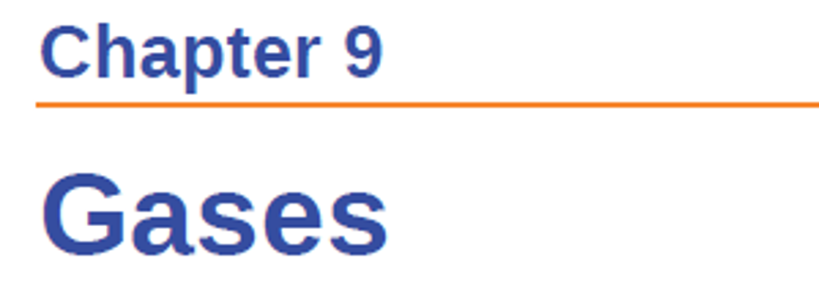
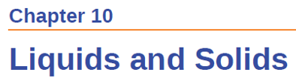
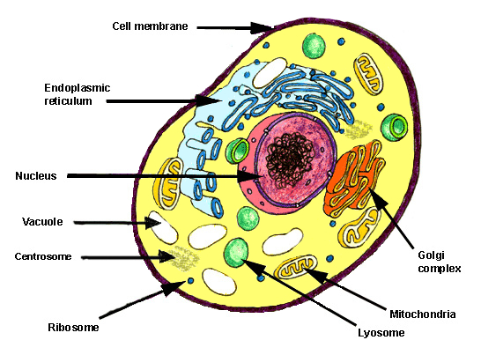
Why solutions matter
A solution is a homogenous mixture of two or more substances
Used in:
Synthetic chemistry
Dilutions
Blood plasma
Synaptic Transmission
DNA replication
Single component systems first because they are “simple.”

Slide 3
Relevant Terminology
Solutions are homogeneous mixtures of two or more substances.
  Dissolving medium is called the solvent
  Dissolved species are called the solute
Dissolution- the process by which a solute forms a solution in a solvent.
  Upon dissolution, solute molecules are surrounded (solvated) by solvent molecules
  Solvent molecules have to rearrange around solute molecules
Soluble – substance that dissolves another substance
Insoluble – substance that does not dissolve another substance
Miscible – liquids that are completely soluble in each other
Immiscible – liquids that are not soluble in each other

Slide 4
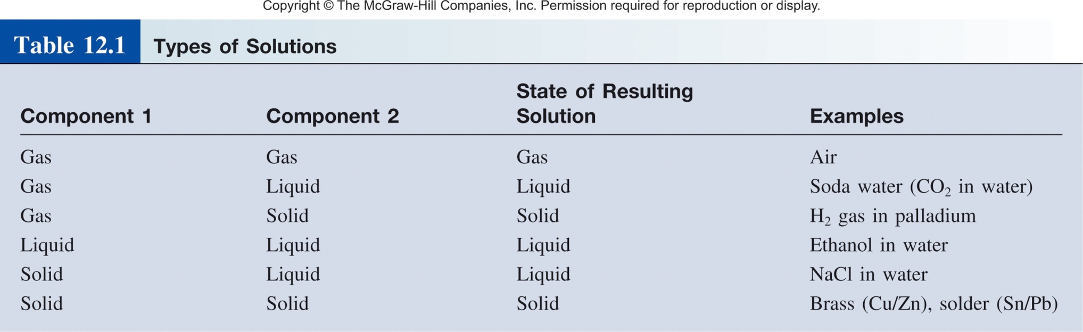
Types of Solutions
The solute is(are) the substance(s) present in the smaller amount(s)
The solvent is the substance present in the larger amount

Slide 5


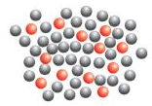
Molecular view of Dissolution
Three types of interactions in the dissolution process:
solvent-solvent interaction
solute-solute interaction
solvent-solute interaction
If
solvent-solute interaction < solute-solute + solvent-solvent
then no mixing:
+
=
+
If
solvent-solute interaction > solute-solute + solvent-solvent
then there is mixing:
+
=

Slide 6
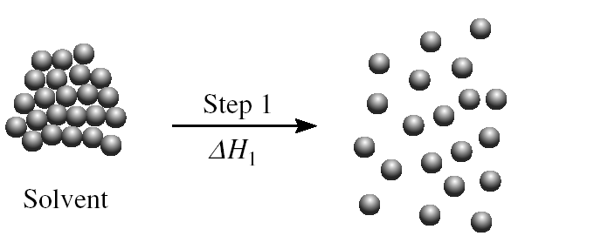
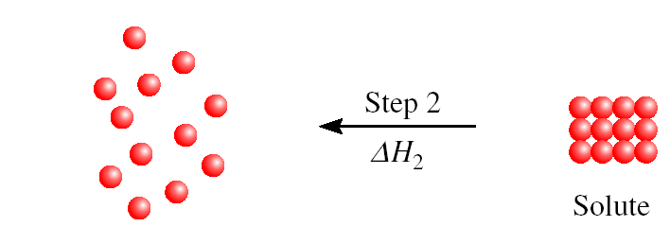
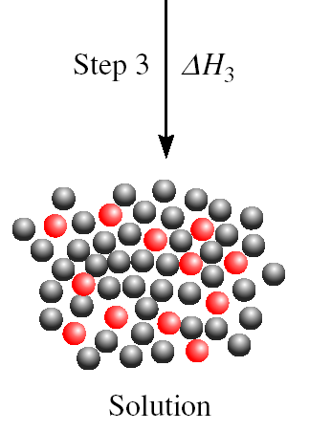
Molecular/Energetic view of Dissolution
ΔH₁ + ΔH₂ are positive
ΔH_{soln} = ΔH₁ + ΔH₂ + ΔH₃
Heat of solution (ΔH_{soln})
ΔH_{soln} > 0, endothermic (energetically unfavorable)
ΔH_{soln} < 0, exothermic (energetically favorable)
Intermolecular Forces!

Slide 7
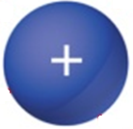

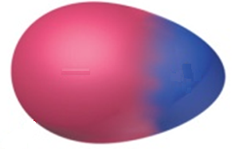

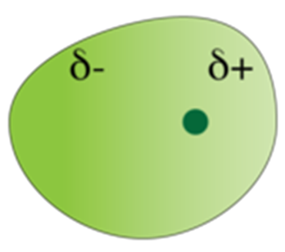
Intermolecular Forces
ion-dipole
dipole-dipole
hydrogen bonding
Induced/instantaneous dipole:
  ion-induced dipole
  dipole-induced dipole
  instantaneous dipole-induced dipole
(40-600 kJ/mol)
(5-25 kJ/mol)
X
H
…
X
(10-40 kJ/mol)
(5-15 kJ/mol)
(2-10 kJ/mol)
(0.05-40 kJ/mol)

Slide 8

Molecular View of the Solution Process
How much in solution?
Effect of Temperature on Solubility
Effect of Pressure on Solubility

Slide 9
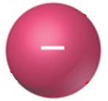

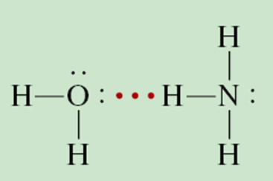
General “Rules” of Solubility
“like dissolves like”
  Nonpolar molecules are soluble in nonpolar solvents.
  Ions and polar molecules are soluble in polar solvents.
  Special Case of polar-polar: Hydrogen bonding solutes are soluble in hydrogen bonding solvents.
Polar-protic solvent

Slide 10
Solutions of Nonpolar Liquids
Nonpolar molecules interact only through weak dispersion forces (instantaneous dipole-induced dipole).
  For example, carbon tetrachloride, benzene, and octane are very soluble/miscible.
  N₂ is more soluble in cyclohexane than it is in water.
N₂

Slide 11
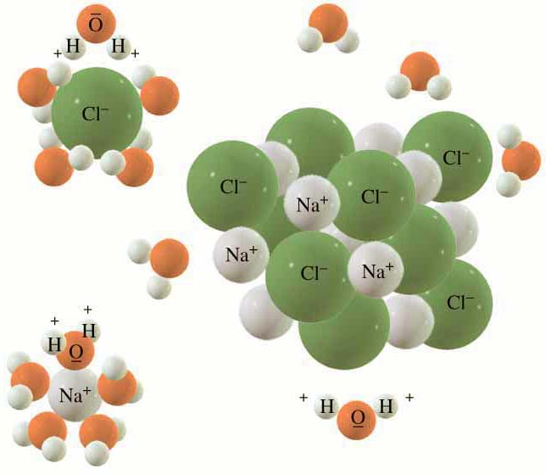
Ionic Solids in Liquid (ion-dipole)
Dissolution for NaCl in H₂O is a competition between:
  Solute-solute attractions
    crystal lattice energy for ionic solids
  Solvent-solvent attractions
    dipole-dipole
    H-bonding
  Solute-solvent attractions
    Ion-dipole interaction

Slide 12
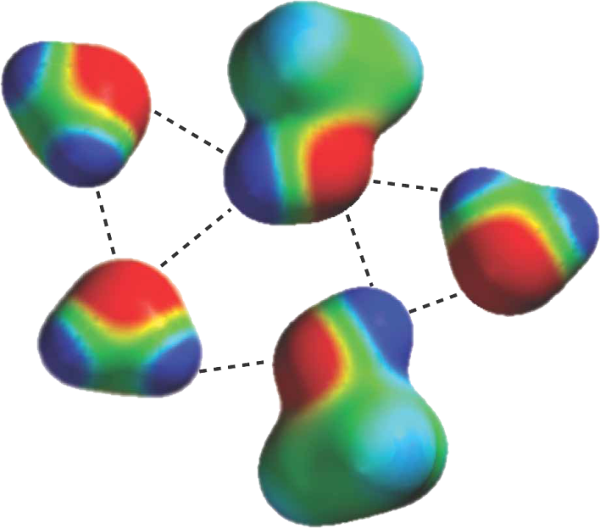
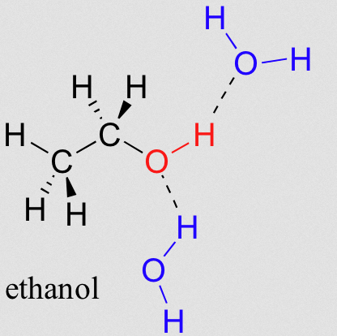
Protic Polar Solvents
  Hydrogen bonding
  Especially important in aqueous solutions
  The primary factor in the solubility of many biological compounds (sugars, aminoacids, etc.)
Water-methanol mixture

Slide 13
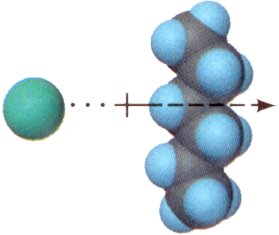

Less Favorable Solutions
Ion - induced dipole forces
  Account for the solubility of ionic salts
  in less polar solvents
  (Example: Cl– in hexane, C₆H₁₄)
Dipole - induced dipole forces
  Contribute to the solubility of nonpolar molecules in polar solvents (N₂ in H₂O)
Cl–
H₂O
N₂

Slide 14
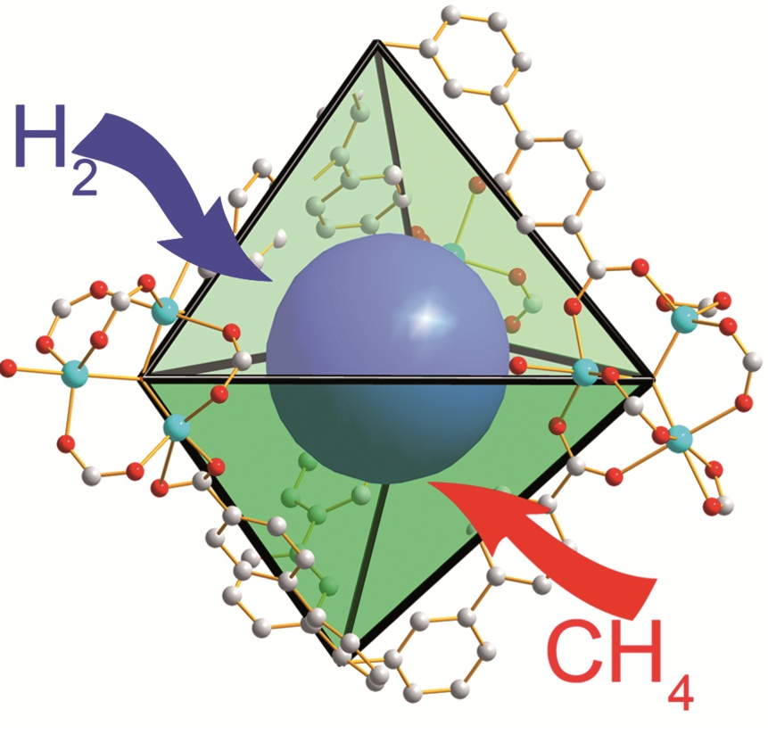
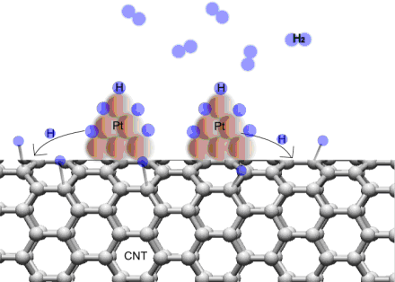
Other Types of Solutions
Gases are infinitely soluble in one another.
Gases usually are only sparingly soluble in solids.
  Hydrogen and Platinum
Gasses in MOFs

Slide 15
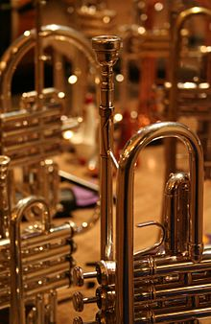
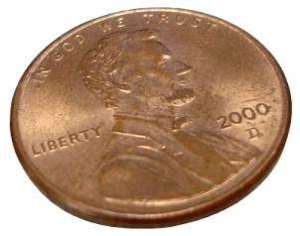

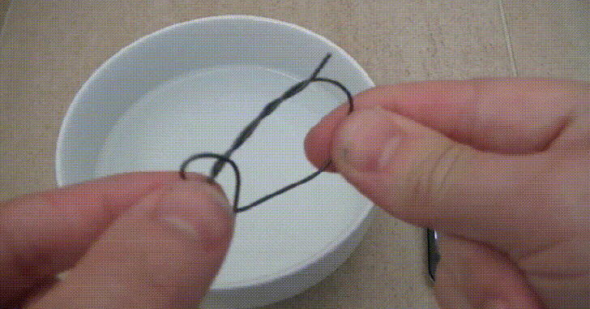
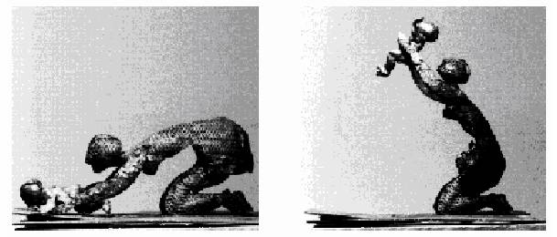
Other Types of Solutions
Alloys are the most important solid-solid solutions
  These solutions have been known for a long time
  They are crucial to the majority of modern technologies.
Brass
Steel
97.5% Zn, 2.5% Cu
Memory Metal
Fe, C
Olivier Deschamps,
'Espoir Desespoir'
Nitinol (NiTi-Alloy)

Slide 16
Types Of Alloys
ALLOY | COMPONENT | USES
Babbitt | Tin, antimony, copper | Bearings
Bell metal | Copper, tin | Bells
Coinage metals | Copper, tin, zinc | Coins
16 karat gold | Gold, copper, silver | Jewelry
Sterling | Silver, copper | Jewelry, flatware
Nichrome | Nickel, iron, chromium, manganese | Heating elements

Slide 17
Question:
Is Bromine (Br₂) more soluble in:
benzene (C₆H₆) or water
A
B
Is KCl more soluble in:
carbon tetrachloride (CCl₄) or ammonia (NH₃)
A
B
Is formaldehyde (CH₂O) more soluble in:
carbon disulfide (CS₂) or water
A
B

Slide 18
Molecular View of the Solution Process
How much in solution?
Effect of Temperature on Solubility
Effect of Pressure on Solubility

Slide 19
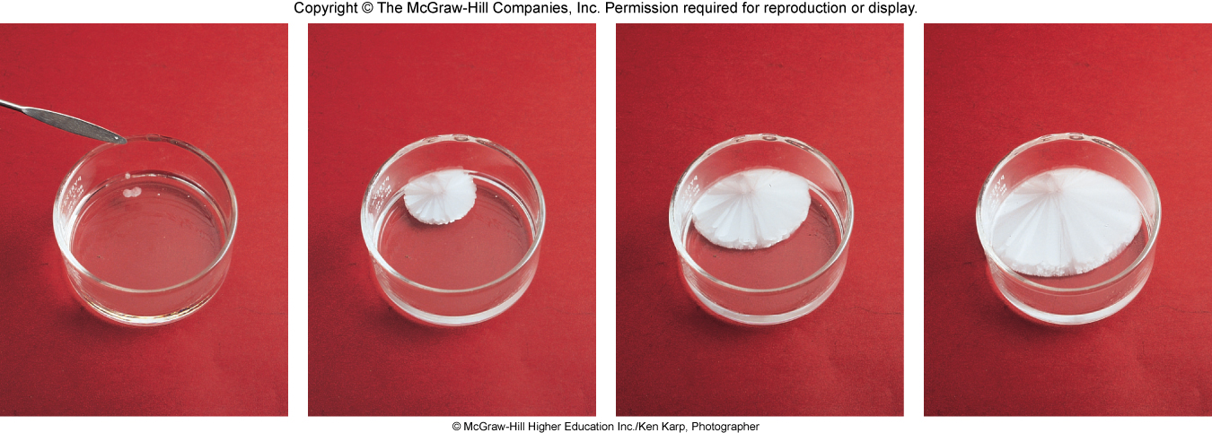
How Much is in Solution?
    Unsaturated solutions contains less solute than the solvent has the capacity to dissolve at a specific temperature.
Saturated solutions contains the maximum amount of a solute that will dissolve in a given solvent at a specific temperature.
    Supersaturated solutions contains more solute than is present in a saturated solution at a specific temperature.

Slide 20
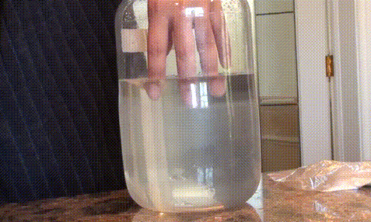
How Much is in Solution?
    Supersaturated solutions contains more solute than is present in a saturated solution at a specific temperature.
Sodium Acetate in water

Slide 21
How Much is in Solution?
Percent by mass
mass of solute (g)
% by mass =
x 100%
mass of solution (g)
Mole Fraction (Χ)
moles of A (mol)
X_{A} =
sum of moles of all components (mol)
Molarity (M)
moles of solute (mol)
Relevant conversions:
Molecular weight (g/mol)
Density (g/mol)
1000 g = 1 kg
M =
liters of solution (L)
Molality (m)
moles of solute (mol)
m =
mass of solvent (kg)

Slide 22
Molecular View of the Solution Process
How much in solution?
Effect of Temperature on Solubility
Effect of Pressure on Solubility

Slide 23
Solubility Temp Dependence
Solubility- the maximum amount of a solute that will dissolve in a given quantity of solvent at a specific temperature.
Solubility is a temperature dependent phenomena.
General Summary:
Solids dissolved in liquids Gases dissolved in liquids
Sol.
Sol.
Tº
Tº
As Tº , solubility
As Tº , solubility

Slide 24
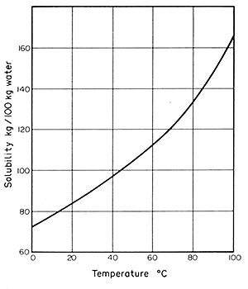
Liquid-Solid Solubility Curves
The relationship between solubility and temperature can be represented by a solubility curve.
Each point in the solubility curve represents a saturated solution.
Any point below a curve represents an unsaturated solution.
Any point above the curve would be a super saturated solution.
Super saturated
Saturated
Unsaturated

Slide 25
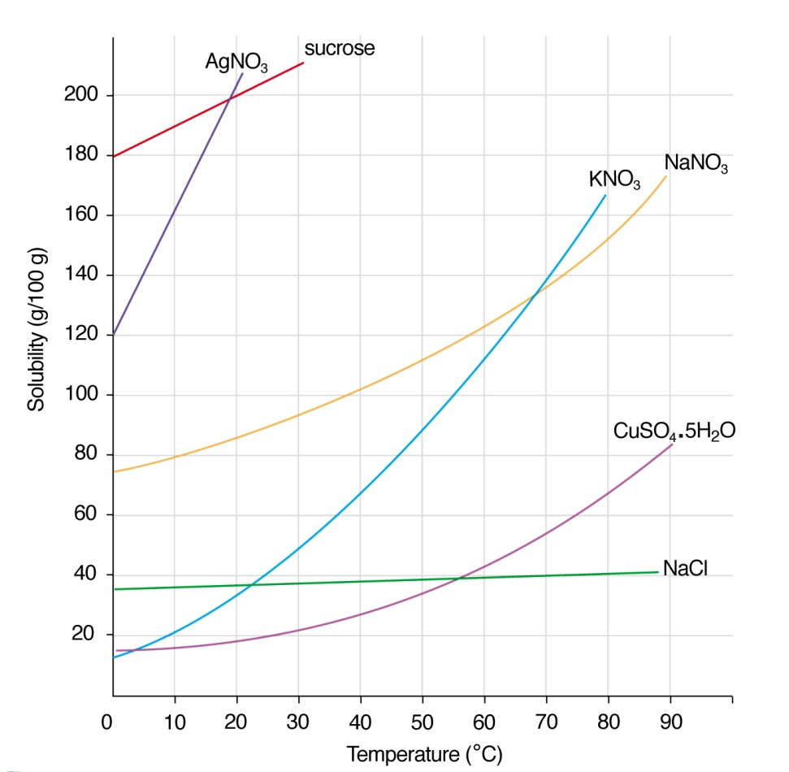
Liquid-Solid Solubility Curves
Solubility: Sucrose > NaNO₃ > NaCl
Generally: solubility of solids in liquids increases with increasing temperature…

Slide 26
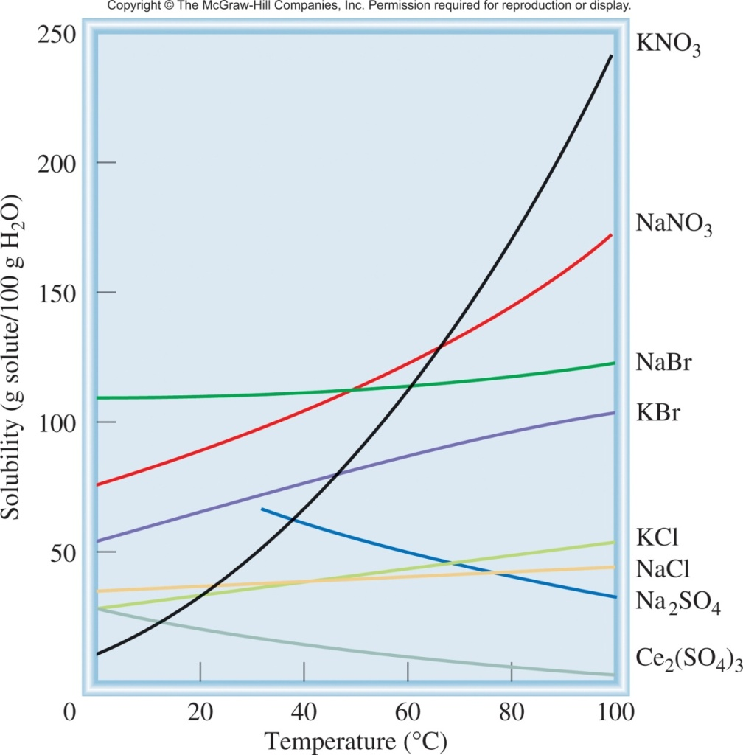
But not always
solubility increases with increasing temperature
+ ΔH_{soln} (endothermic)
solute + solvent + heat
solution
increasing temp
solubility decreases with increasing temperature
− ΔH_{soln} (exothermic)
solute + solvent
solution + heat
increasing temp

Slide 27
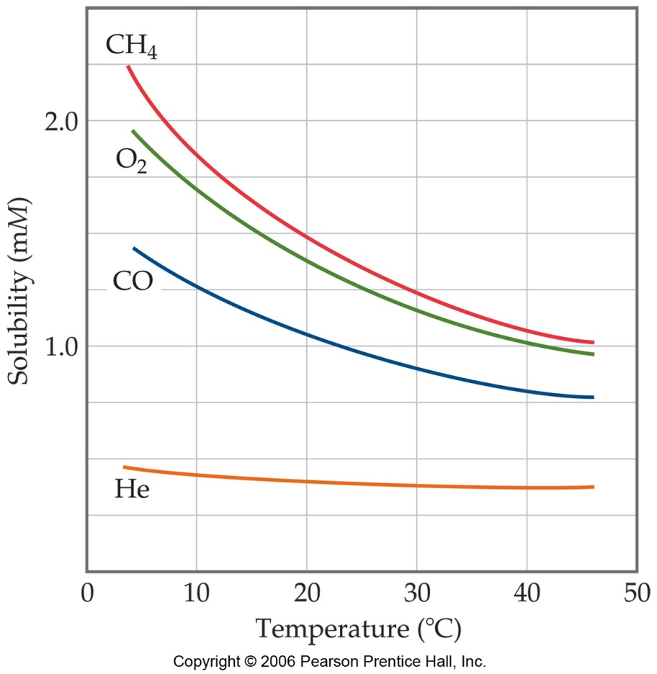
Liquid-gas Solubility Curves
solubility of gasses “always” decreases with increasing temperature
Carbonated beverages go “flat” as they warm due to a decreased solubility of dissolved CO₂
Bubbles form on the inside wall of a cooking pot when water is heated even though the temperature is well below boiling
Thermal pollution of lakes and streams causes low oxygen levels in deeper layers

Slide 28
Molecular View of the Solution Process
How much in solution?
Effect of Temperature on Solubility
Effect of Pressure on Solubility

Slide 29
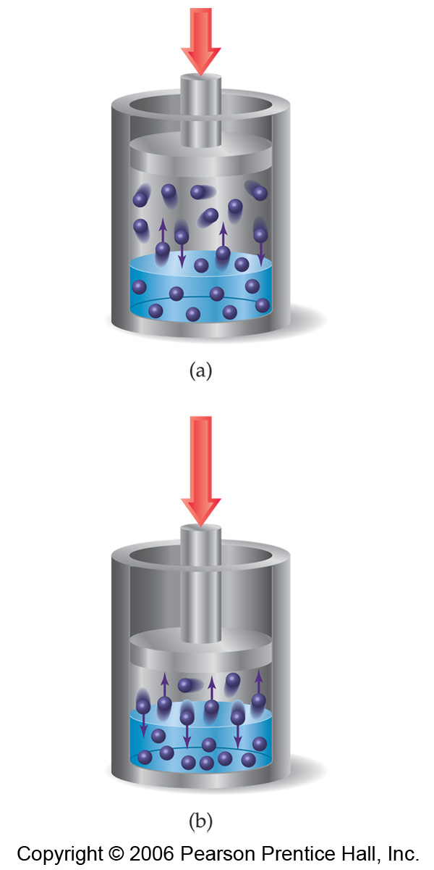
Pressure and Solubility
The solubilities of solids and liquids are not affected appreciably by pressure
When the pressure of a gas is increased, the rate at which gas molecules enter the solution increases
The concentration of solute molecules at equilibrium increases in proportion to the pressure
So the solubility of a gas increases with pressure

Slide 30
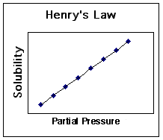
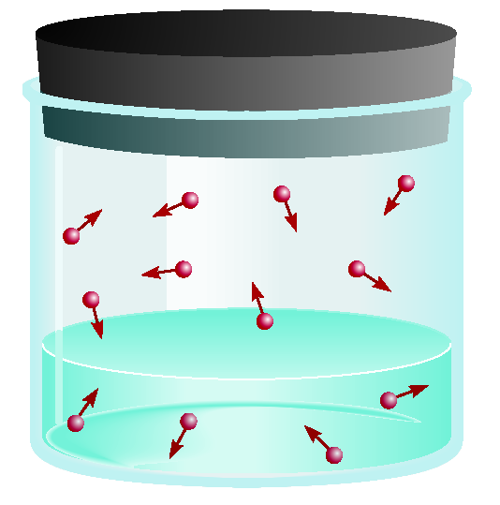
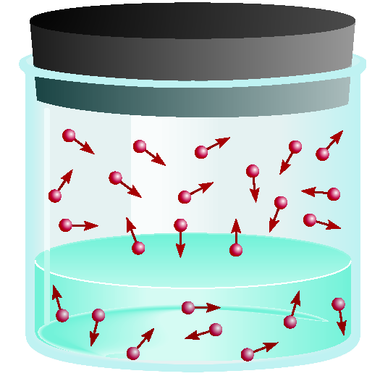
Pressure and Solubility of Gases
The solubility of a gas in a liquid is proportional to the pressure of the gas over the solution (Henry’s law).
c is the concentration (M) of the dissolved gas
c = kP
P is the pressure of the gas over the solution
k is a constant for each gas (mol/L•atm) at a given temperature
low P
high P
low c
high c

Slide 31
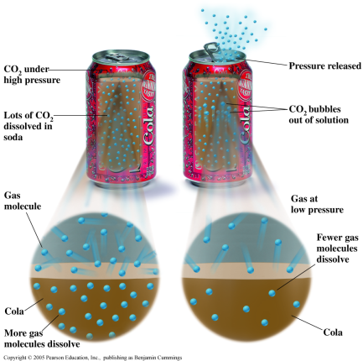
Pressure and Solubility
Soft drink bottled under CO₂ pressure greater than 1 atm
When the bottle is opened, partial pressure of CO₂ above the solution decreases
Solubility of CO₂ decreases
-> bubbles
Bubbles until it reaches equilibrium

Slide 32
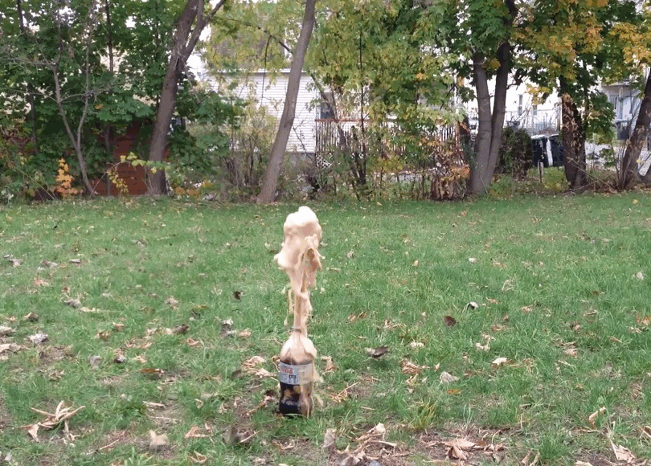
Pressure and Solubility
  Variables:
  dipole-dipole of water
  surface tension
  CO₂ concentration
  nucleation sites
  surface area
Bubbles form when CO₂ molecules congregate next to nucleation sites, which break up the network of water molecules. When enough are gathered, they form a bubble.
Mentos- rough high surface area = more nucleation sites
gum arabic = reduces surface tension of water

Slide 33
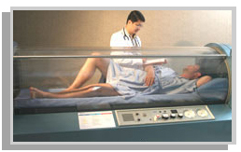
The Bends
Deeper diving has higher pressures
  Dreathing tank (atm = 78% N₂, 21% O₂, etc.)
  Deep sea high pressure forces N₂ to dissolve in higher amounts in blood.
If ascension is too fast, lower external pressure causes N₂ to start bubbling out of blood too quickly
  Rupturing of arteries
    Excruciatingly painful death
    Must be rushed to hyperbaric chamber
Tanks now don’t use N₂, but He
  He is small and can diffuse
  through tissue quicker.

Slide 34
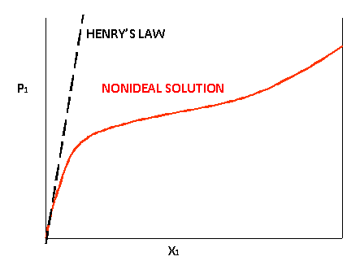

Exceptions to Henry’s Law
P
c = kP
c
Reactions with the solution:

Slide 35
Molecular View of the Solution Process
How much in solution?
Effect of Temperature on Solubility
Effect of Pressure on Solubility

